Slide 1
Image Reconstruction using Autoencoder
Presented By: V.Poojasri,
BE.CSE,
Builders Engineering College,
poojaviji2004@gmail.com,
DB28319CA3F3833800940B96D36D892A

Slide 2
PROJECT TITLE
Image Reconstruction using Autoencoder

Slide 3
AGENDA
Problem Statement
Proposed System/Solution
System Development Approach
Algorithm and Development
Result
Conclusion
References

Slide 4
Problem Statement
The problem statement of image reconstruction using an autoencoder involves the creation of a model capable of learning an efficient representation of input images and subsequently reconstructing them with minimal loss of information. Autoencoders are a type of artificial neural network designed for unsupervised learning, where the input is encoded into a lower-dimensional representation (latent space) and then decoded back into the original input space.

Slide 5
Proposed Solution
Autoencoder Architecture Design :
Encoder: this module takes the input data from the train-validation-test set and compresses it into an encoded representation. Typically, the coded image data is smaller than the input data.
Bottleneck: the bottleneck module keeps the knowledge representation compressed and makes it a critical part of the network. The data dimension becomes a decreasing barrier.
Decoder: The decoder module is crucial in restoring the data representation to its original form by “decompressing” it. The resulting output from the decoder is then compared to either the ground truth or the initial input data.

Slide 6
WHO ARE THE END USERS?
Researchers and Academia
Industry Professionals
Developers and Engineers
End-users of Consumer Products
Data Scientists and Machine Learning

Slide 7
YOUR SOLUTION AND ITS VALUE PROPOSITION
High-Quality Image Reconstruction: Our solution employs advanced autoencoder architectures trained on large datasets to achieve high-quality image reconstruction. By leveraging the power of deep learning, we can effectively reconstruct images with minimal loss of information, resulting in visually appealing and accurate reconstructions.

Slide 8
THE WOW IN YOUR SOLUTION
The "wow" factor in our Image Reconstruction using Autoencoder solution lies in its ability to seamlessly blend cutting-edge technology with real-world applications, delivering tangible and impactful results.

Slide 9
MODELLING
With autoencoders, we pass input data through an encoder that makes a compressed representation of the input. Then, this representation is passed through a decoder to reconstruct the input data. Generally the encoder and decoder will be built with neural networks, then trained on example data.

Slide 10
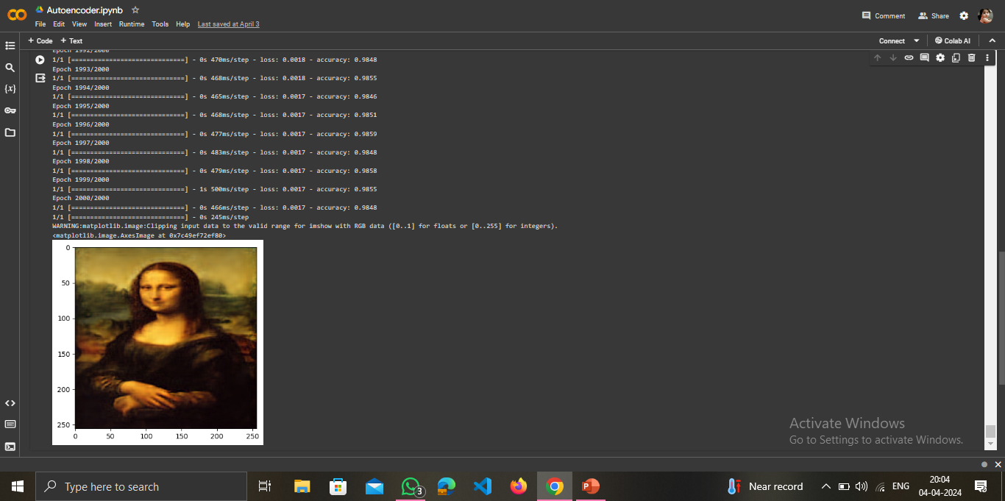
Result

